Slide 1

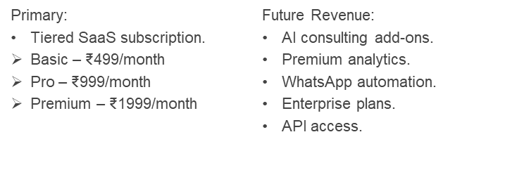
IBM SkillsBuild
TechNova
0.1
Small business owners lack time to analyze reviews, sales, and inventory. Hiring consultants or digital marketing agencies is expensive. Business decisions are often based on intuition rather than data, leading to missed opportunities and unnecessary waste.
Multi-agent AI analyzes reviews, sales, and inventory.
AI generates personalized marketing campaigns and customer engagement.
Executive dashboard with AI-powered business recommendations.
MerchantMind AI is an autonomous team of AI agents that helps small businesses grow by analyzing operations, generating insights, and recommending business decisions in real time.
Agentic AI architecture with specialized collaborating agents.
Unified business intelligence from multiple operational data sources.
Modular platform that scales from a workshop MVP to a full SaaS solution.
Designed specifically for small businesses that lack dedicated analysts or consultants.
Manual Excel spreadsheets
Google Business Dashboard
Meta Business Suite
Manual decision-making based on owner experience
Hiring marketing agencies
Business consultants
Number of businesses onboarded.
Number of AI analyses performed.
Time saved per business.
AI-generated recommendations accepted
Customer satisfaction.
Analysis completion time.
Quality of generated business reports.
GitHub Copilot meets HubSpot, but for local businesses, with a team of AI agents instead of human consultants.
Basically, An AI COO (Chief Operating Officer) for every small business.
Direct outreach to local businesses
LinkedIn
Instagram
Startup competitions
College innovation events
Referrals
Future SaaS website
Businesses that:
Already use Google Business Profile.
Receive customer reviews regularly.
Manage inventory manually or in Excel.
Are active on Instagram or Facebook.
Want to improve operations but can't afford consultants.
Fixed Costs
Cloud hosting
Domain
Database
Product Development
Variable Costs
LLM API usage
Cloud storage
Monitoring & logging
Customer support
Marketing & customer acquisition

